Slide 1
Reducing Software Debt With Reproducible Containers
Tanu Malik
School of Computing
DePaul University
Chicago, IL
Second Software Sustainability Institute Workshop, 2018

Slide 2
Debt
Notes:
We all are familiar with some form of debt; As earning members of the society; Debt is a weight or burden that we choose to carry as part of our financial transactions.
Often buying that dream house by taking on some debt not only gets you the house it is cheaper than the alternative of continuing to rent.

Slide 3
Software Debt
Journal Deadline
Good Scientific Software
Productivity
Software
Debt
Crappy Scientific Software
Time
Notes:
Software incurs the same debt. We incur software debt when submitting to that first journal we wrote crappy software which was ok, but if we continue to do so for every deadline, we accrue software debt

Slide 4
Consequence of Debt
IRREPRODUCIBLE
CONFISCATED

Slide 5
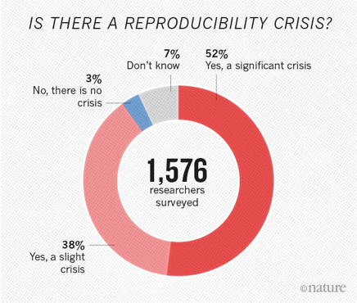
Scientific Reproducibility Crisis
Source: 1,500 scientists lift the lid on reproducibility. Nature Survey. Corrected 25th May, 2016. Accessed April 13th, 2016

Slide 6
Assistive Reproducibility Tools
Journal Deadline
Good Scientific Software
Productivity
Software Debt
Assistive
Reproducibility
Tools
Crappy Scientific Software
Time
Notes:
The

Slide 7
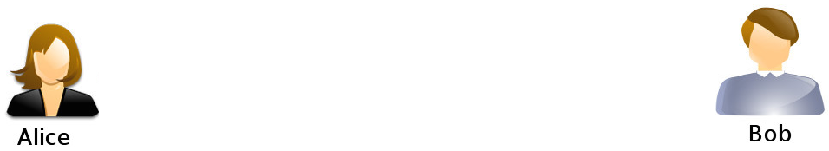
Share and Repeat an Application
Alice wants to share her input data files and program source code with Bob
Bob wants to repeat Alice’s application to validate her inputs and outputs.

Slide 8
Alice’s options
A tar and gzip
Build a website with model code, parameters, and data
Submit to a repository such as GitHub, DockerHub
Create a virtual machine

Slide 9


Sciunit: A Reproducible Platform
2. Share
3. Run
1. Create
Globus RDP

Slide 10

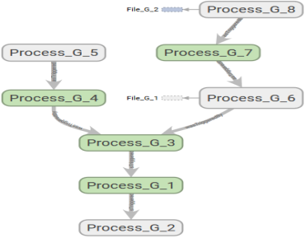
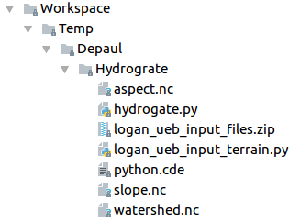
Sciunit platform creates sciunits
Annotated, Versioned,
Lineage-tracked,
Runnable Package
Annotated, Versioned,
Lineage-tracked,
Runnable Package
Annotated, Versioned,
Lineage-tracked,
Runnable Package
Provenance
Provenance
Provenance
Annotations
Sciunit | Mysciunit
Author | Tanu Malik
… | …
Annotations
Sciunit | Mysciunit
Author | Tanu Malik
… | …
Annotations
Sciunit | Mysciunit
Author | Tanu Malik
… | …
Annotations
Annotations
Annotations
Package
Package
Package

Slide 11
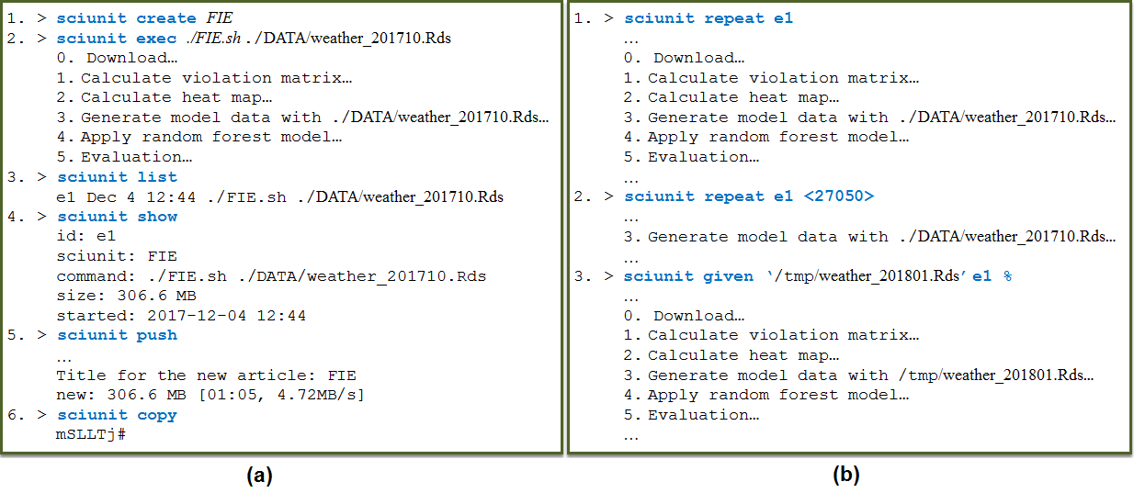
Sample Interaction
Host Computer
Target Computer
Notes:
Git-like, versioning,

Slide 12
Sciunit Tool: Automatic Containerization
Tools downloaded 500 times from website
50 sciunits tracked on Hydroshare
Featured at a HPDC workshop
50 active users
5 contributors to the project
Browse: http://sciunit.run
Contribute: https://bitbucket.org/geotrust/sciunit-cli
Issues: pr@sciunit.run

Slide 13
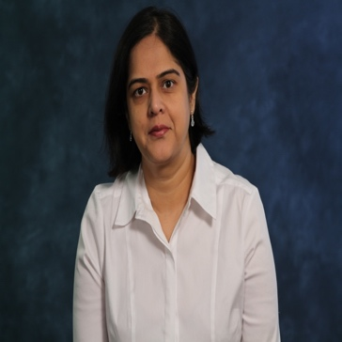
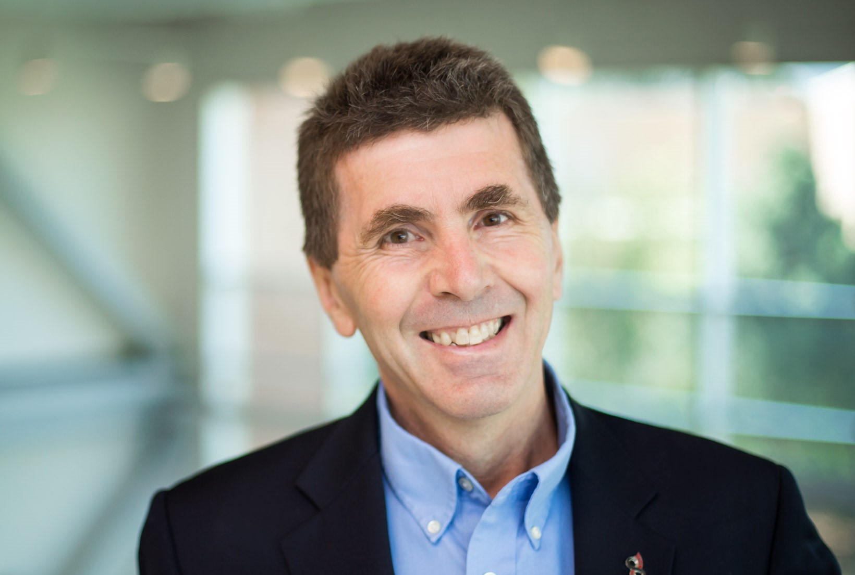
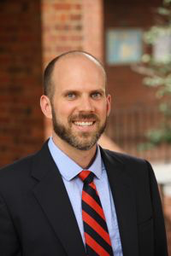
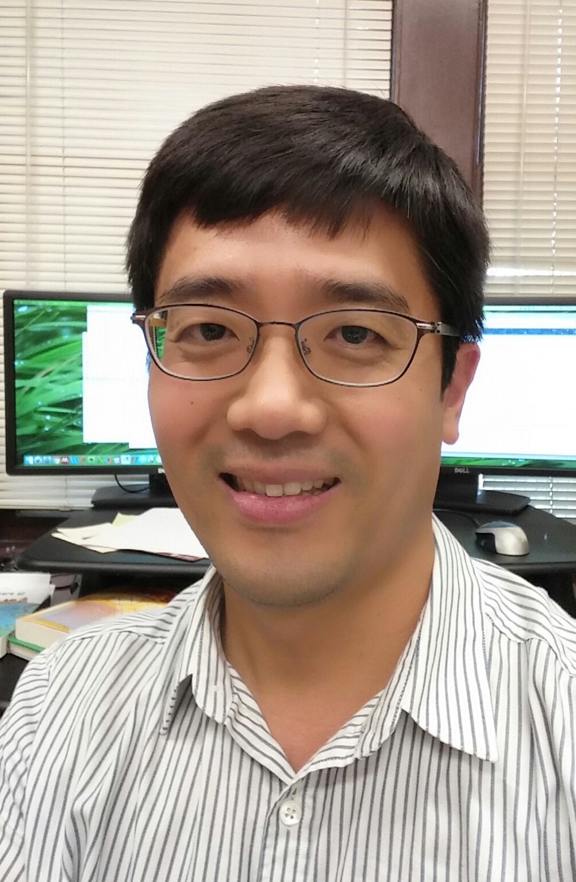
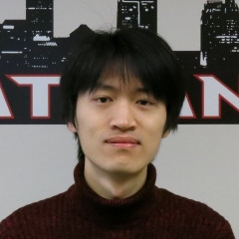
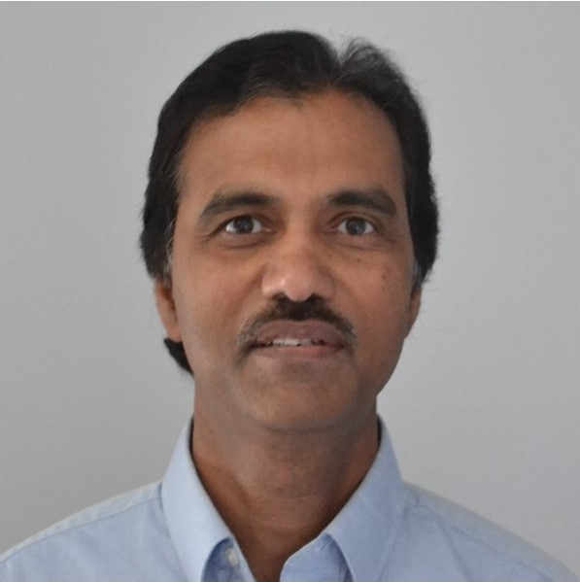
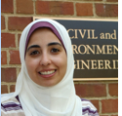
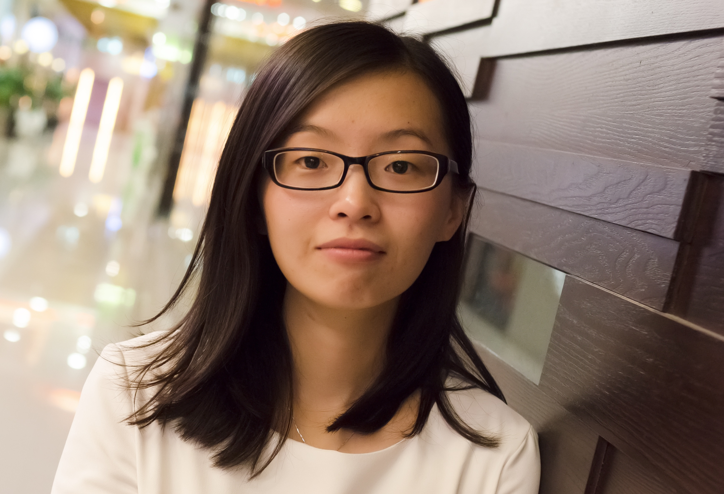
GeoTrust
3 year EarthCube Capability project
Across 3 geoscience domains
Involves 3 early career scientists, 5 PhD students
CyberInfrastructure
Hydrology
Solid Earth
Space

Slide 14
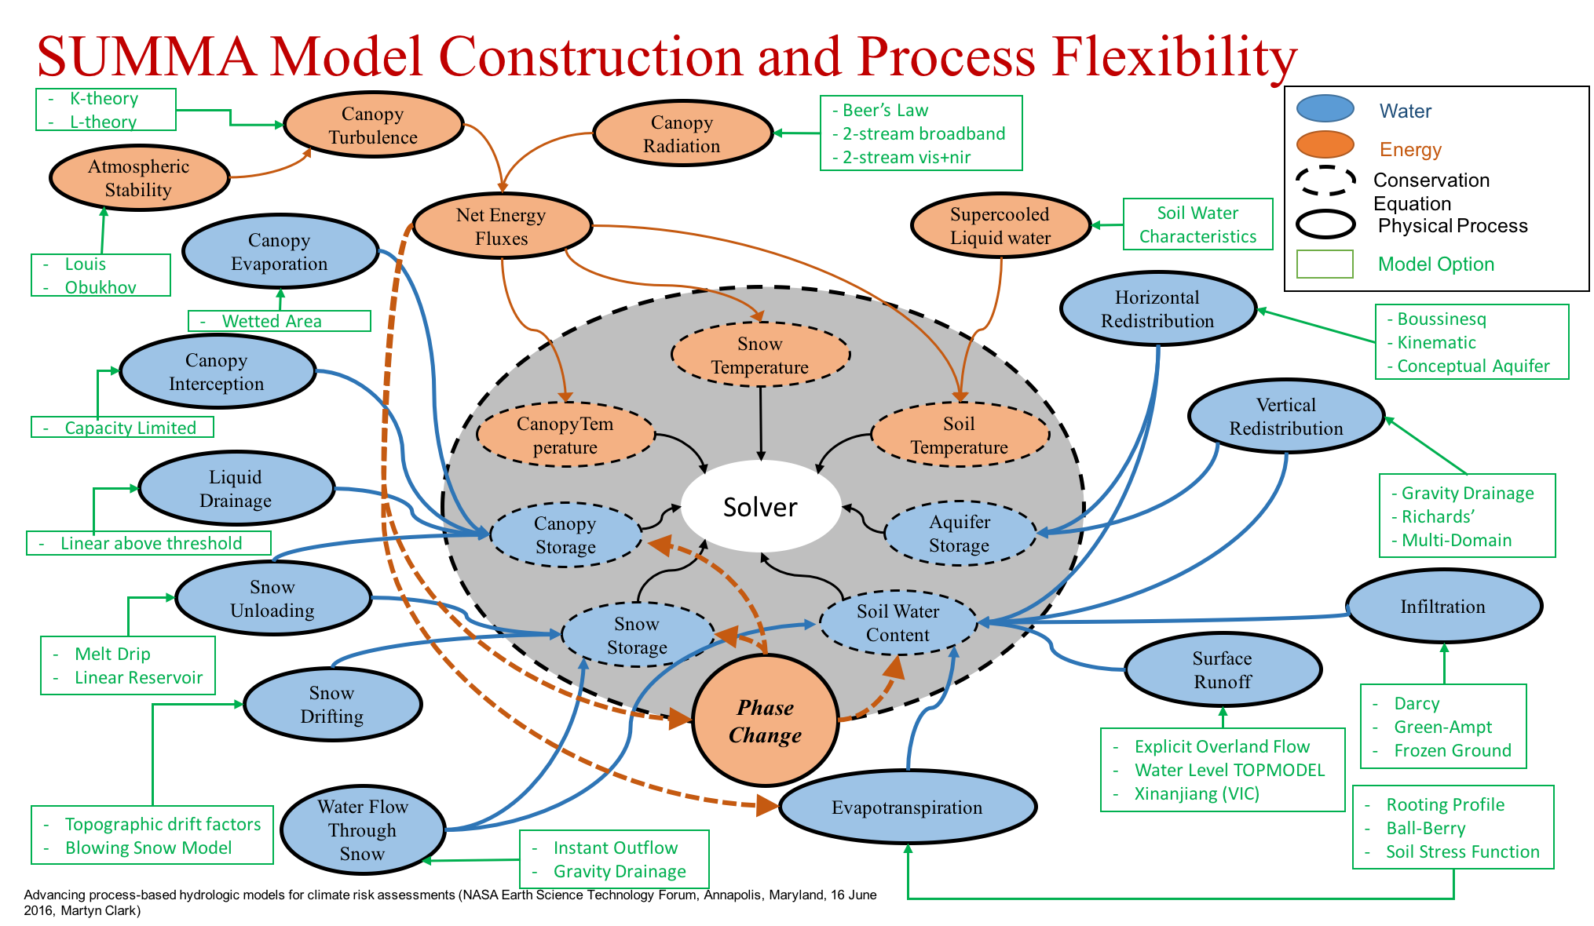


Current Work
sciunit repeat run_my_driver.in​
run_my_driver.in​
​
interface​ analysis_drivers = e1​
fork​ parameters_file = 'sample.params'​ results_file = 'sample.output'​
​
2.4-2.6
1.0-1.2
2.4-2.6
1.0-1.2
1.2-1.4
1.2-1.4
2.2-2.4
2.2-2.4
1.8-2.0
1.6-1.8
1.8-2.0
1.6-1.8

Slide 15
Acknowledgements
Browse: http://sciunit.run
Contribute: https://bitbucket.org/geotrust/sciunit-cli
Issues: pr@sciunit.run
National Science Foundation grants ICER-1639759,
ICER-1661918, ICER-1440327, ICER-1343816

Slide 17
BACKUP SLIDES

Slide 18
Solution Space
Virtualization
Distributed Version Control
portable
self-contained
versioned
repeatable
collaborative
Research Object
documented
No easily creatable, readily reusable, efficiently versioned,
discrete unit of computation exists

Slide 19
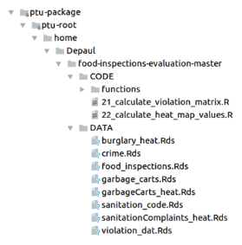
Packaging Details
1) Attach to process
2) Intercept system calls
3) Copy files / executables
4) Log system calls

Slide 20
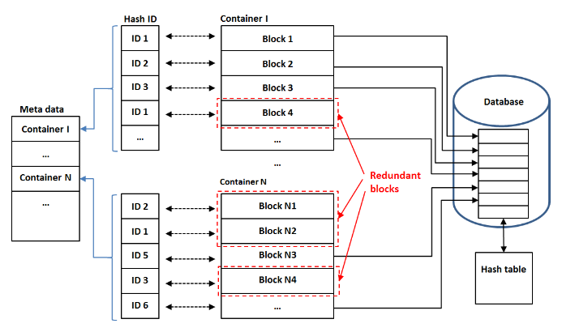
Storage and Retrieval
Store package:
Retrieve package:
1) Archive package-root
2) CDC on archive
3) Store manifest
1) Retrieve manifest
2) Concatenate chunks
3) Extract archive
Deduplicated Container Storage

Slide 21
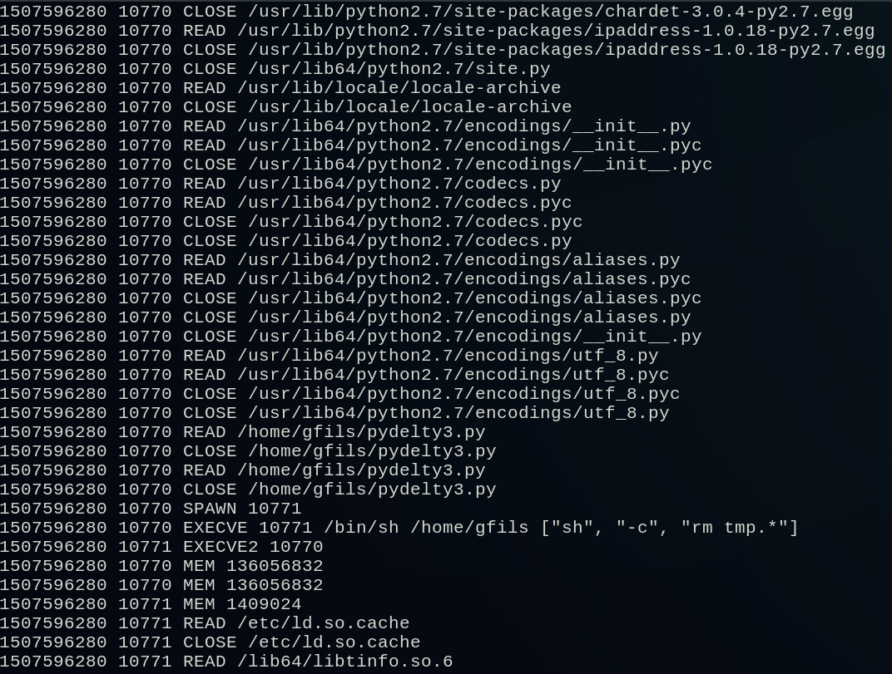
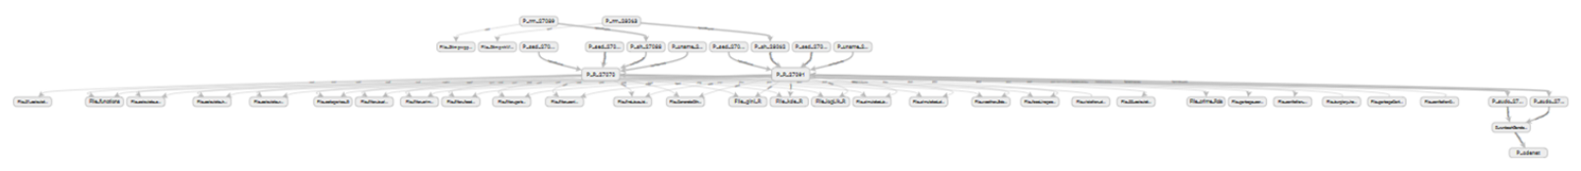
Provenance
Part Of A Normal (Verbose) Provenance Log
Small Section Of Graph Built From Normal Provenance Log

Slide 22
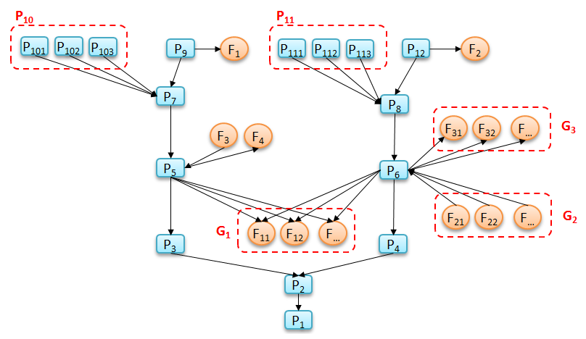
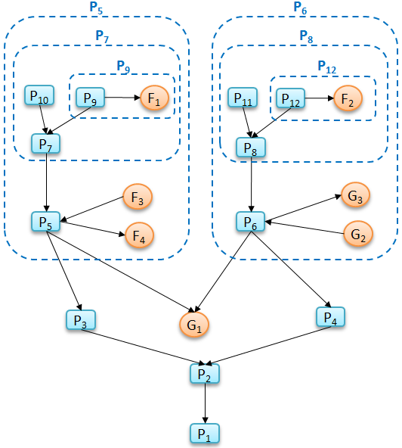
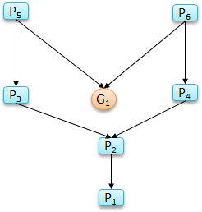
Summarization: Group By Similarity
Group vertices by type/connections
Find min-connected nodes, pack into hubs
Packability Applied
Full Graph
Similarity Applied

Slide 23
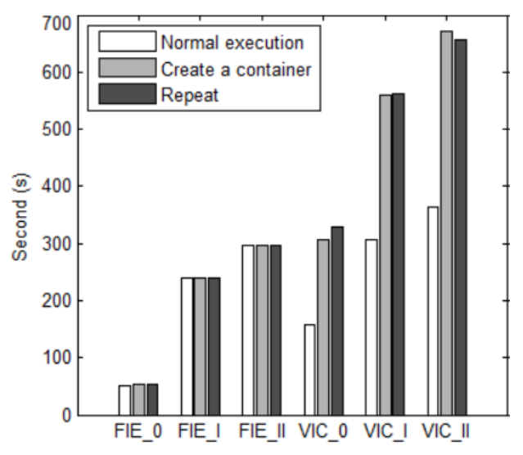
Package and Repeat
1) Run app normally
2) Run with package
3) Run with repeat
I/O-intensive apps: VIC
Non-I/O-intensive apps: FIE
Package/Repeat Runtimes

